Slide 1
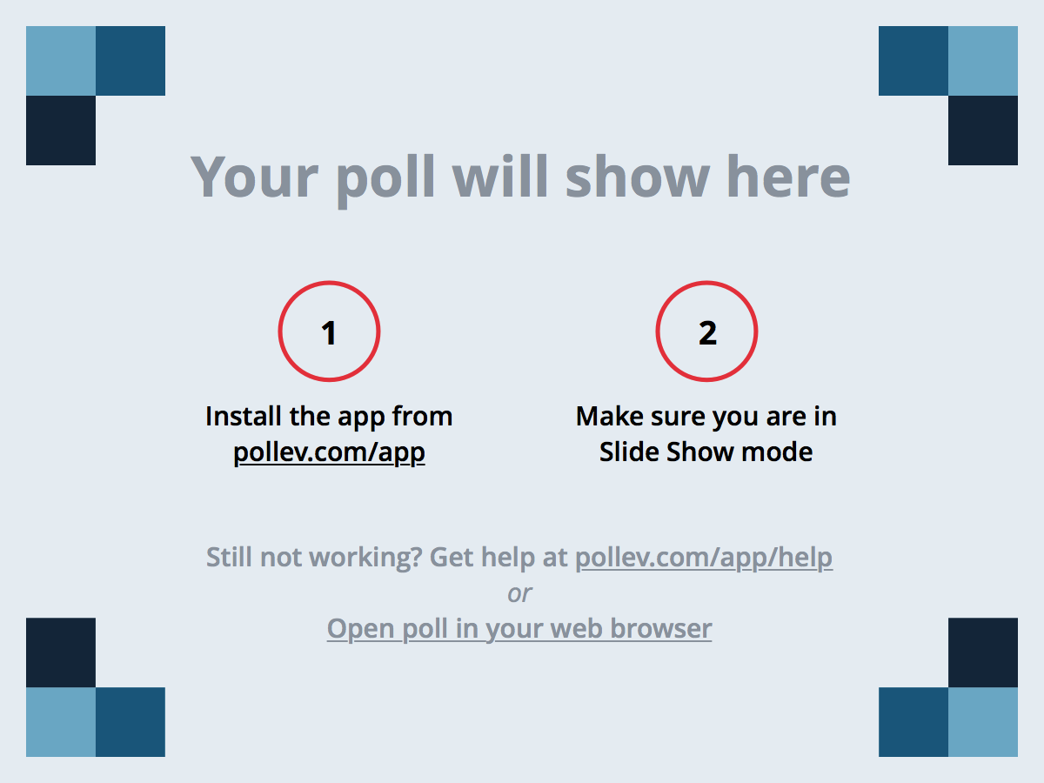
Notes:
How are you feeling?
https://www.polleverywhere.com/free_text_polls/VN2fGJURkn90HZG

Slide 2
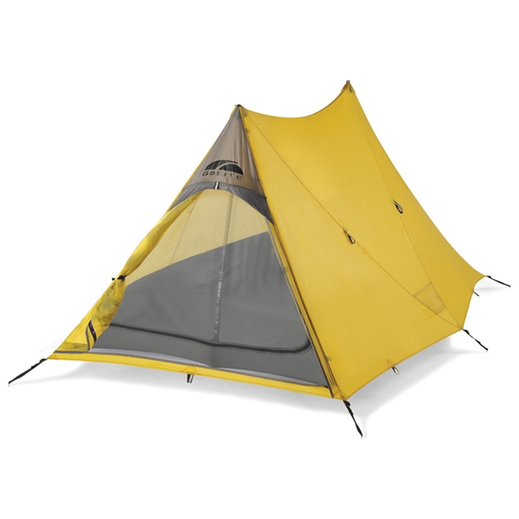
Welcome!

Slide 3
CS 608 Algorithms
Week 1 Dr. Tom Schmidt

Slide 4
Week 1 Agenda
Introductions
About me
Orientation to the course
Overview of materials and resources.
Student expectations.
A Metaphor
Wrap-up and review

Slide 5
Week 1 Objectives
After your readings and this lecture, you will be able to:
Understand some issues related to Algorithms, and your participation in the course
Materials:
Syllabus, Week 1 PPT, Cardboard, Markers
Learners!

Slide 6
Introductions
Please take 8 minutes to interview the person with whom I have paired you
Get the lowdown on:
Name, where from, what does s/he think of Pace, and why is s/he here (also ask if teaching is in hir future) ( at Pace or in class)
Most impressive course ever taken, and why
What computer program or app could s/he not live without?
How does s/he approach solving the problem of getting home from Campus tonight?
Be Prepared to tell a 1-minute story about your interview partner

Slide 7
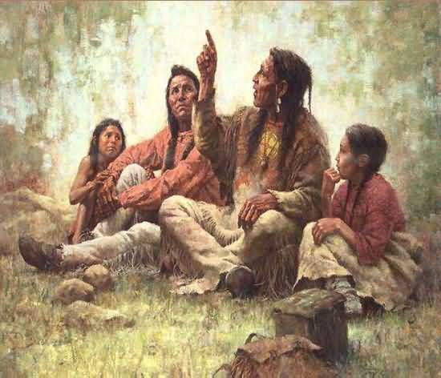
My Story
7

Slide 8
How you should address me?
Some past favorites:
Tom
Dr. Schmidt
“Dr. Tom”
“Doc”
Professor
Sir

Slide 9
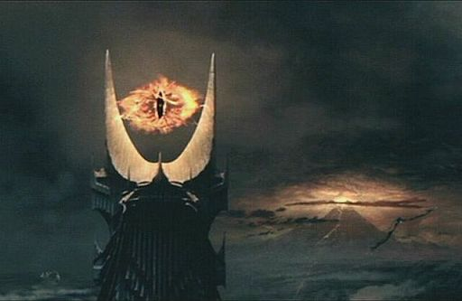
One last thing…

Slide 10
Student? Learner expectations for the course
10
In which you talk, I listen

Slide 11
Orientation to the course
11
Syllabus Review
Some Things I intend to do in this course
Student Leading?
Real-world application(s)
Learn from you: weekly management

Slide 12
Syllabus Review
Assignments
Grading
Weekly Topics

Slide 13
Assignments from the Syllabus
Homework (15%)
Participation (20%)
Google Interview Required (5%)
Quizzes (25%)
Midterm Exams (15/25%)
Final Exam (15/25%):
Someone check that!

Slide 14
Homework 15%
There will be 3 or 4 homework problems due every week; most will be HackerRank programming assignments
You should turn them in AFTER class, when we perfect them, on the 2nd day of the week, and BEFORE class on the first day of the week

Slide 15
Participation 20%
Qualitative and Quantitative
You both need to show up, and to produce
Let’s discuss and go to the class Google Sheet

Slide 16
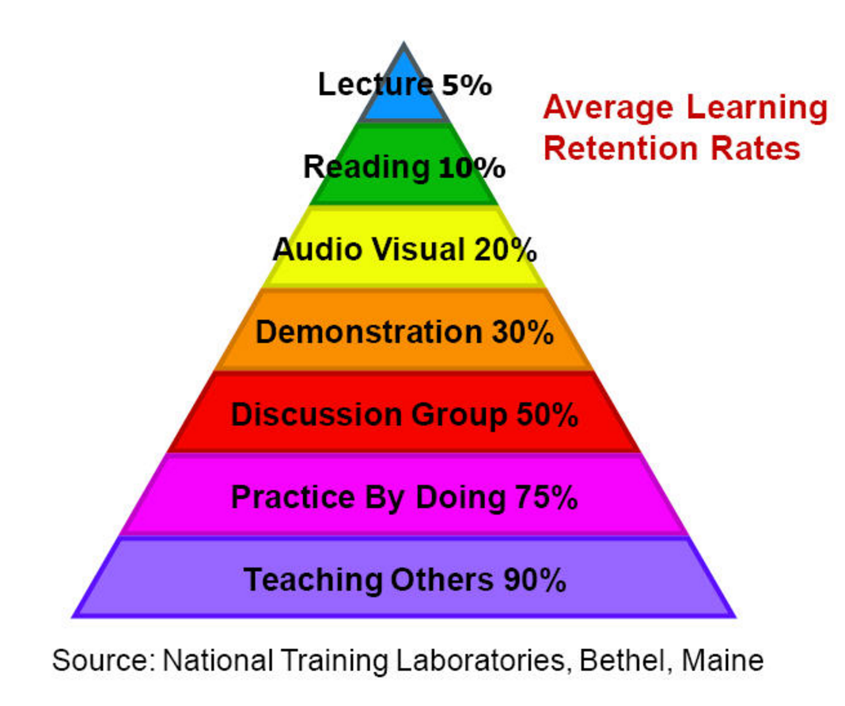
The Learning Pyramid

Slide 17
Participation 20%
What’s this Google Interview?

Slide 18
Quizzes 25%
I can give you the relevant chapter of “Make it Stick”

Slide 19
Midterm Exam
Week of 3/20, cumulative to that date
We will sculpt the midterm in class

Slide 20
Final Exam
In May, 75% post-Midterms material

Slide 21
Grading, Shorthand
A: Impress Me/Teach Me Something
B: Please Me
C: Satisfy Me
D: Annoy Me
F: Reject the idea of learning, entirely
Or, cheat

Slide 22
Notes:
Which of these is the highest percentage of your grade?
https://www.polleverywhere.com/multiple_choice_polls/1YLzBzmR47hZjco

Slide 23
Textbooks
Introduction to Algorithms, Third Edition, Thomas H. Cormen, Charles E. Leiserson, Ronald L. Rivest, and Clifford Stein, The MIT Press, 2009.
I love this book.

Slide 24
Weekly Topics
Before we go on, about next week…

Slide 25
Weekly Topics
Weekly Topics
A tour through each, briefly

Slide 26
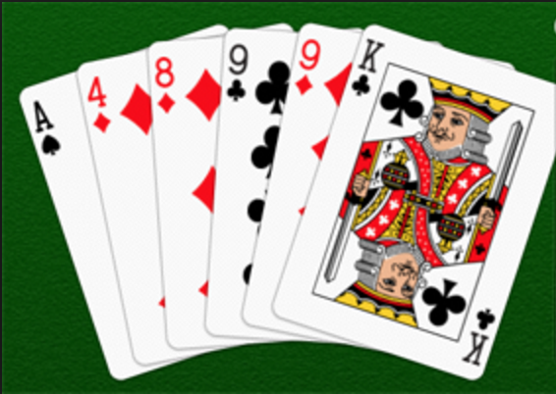
Weekly Topic: Intro and Sorting

Slide 27
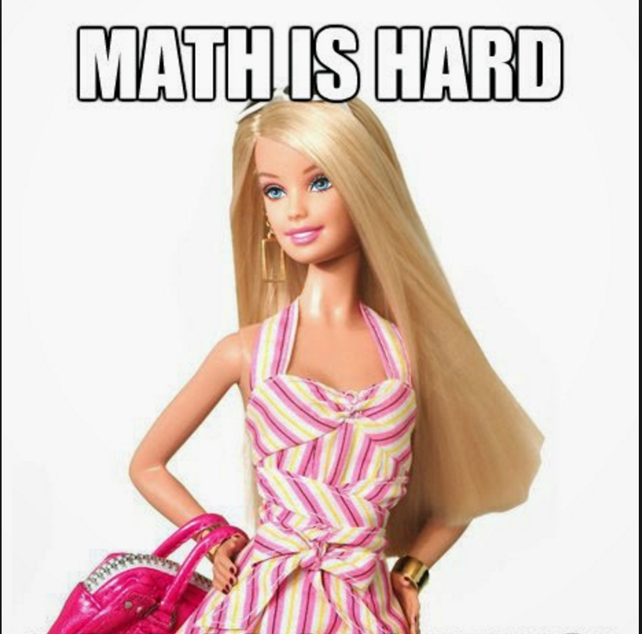
Weekly Topic: Math; Strassen’s Algorithm

Slide 28
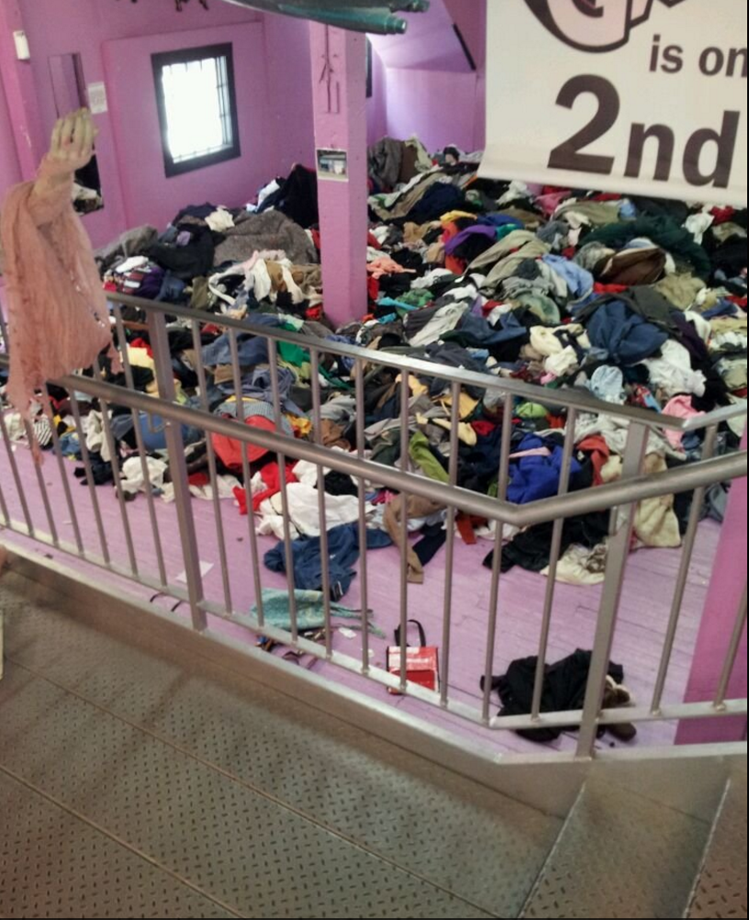
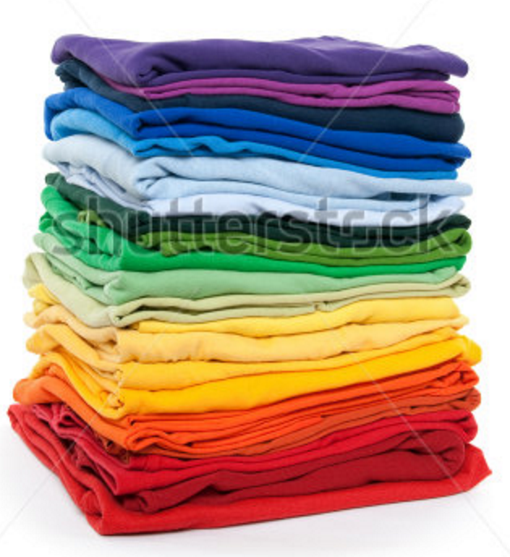
Weekly Topic: Recurrences; Loop Invariants; Heapsort

Slide 29

Sorting Boundaries, Radix Sort, Deterministic Selection Randomized Analysis

Slide 30
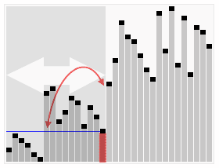
Indicator Random Variables; Quicksort, Randomized Selection

Slide 31
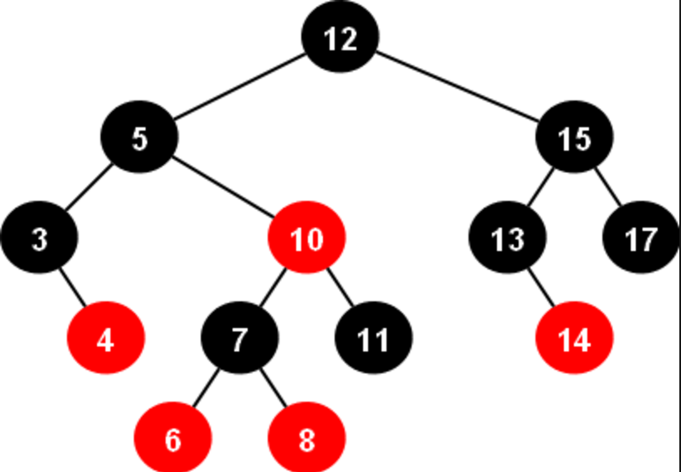
Red-Black Trees

Slide 32
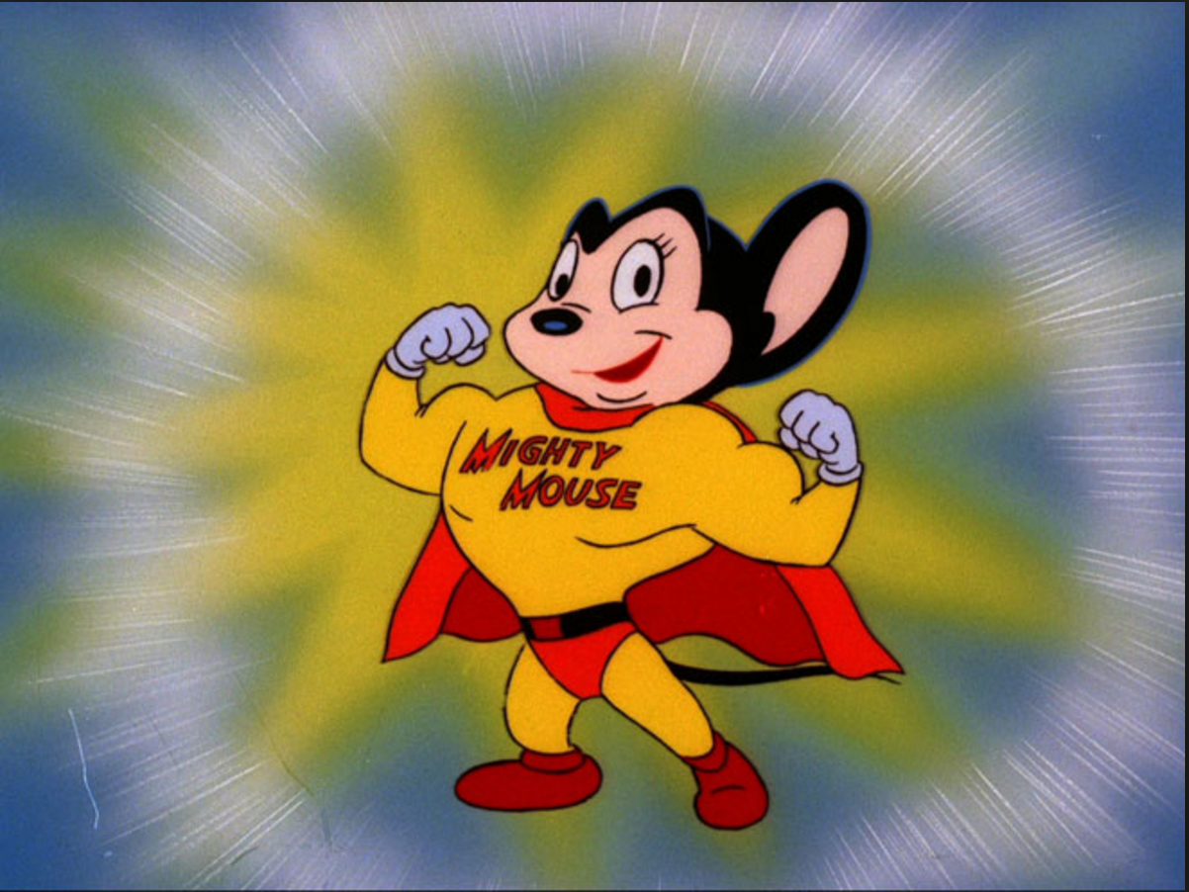
Dynamic Programming

Slide 33
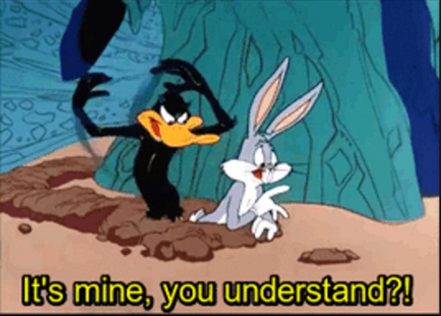
Greedy Algorithms

Slide 34
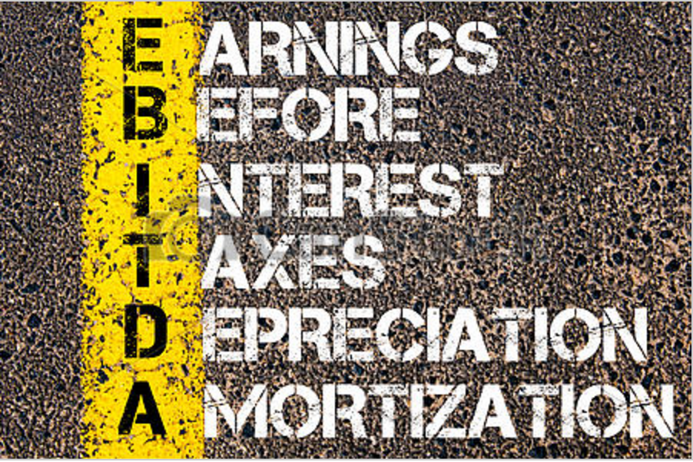
Amortized analysis

Slide 35
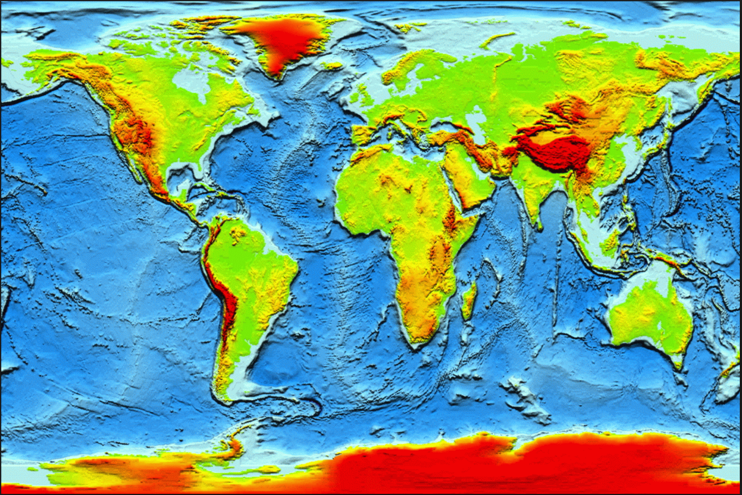
Graph Algorithms, BFS, DFS, Topological Sort Strongly Connected Components, Minimum Spanning Trees, Disjoint Sets

Slide 36
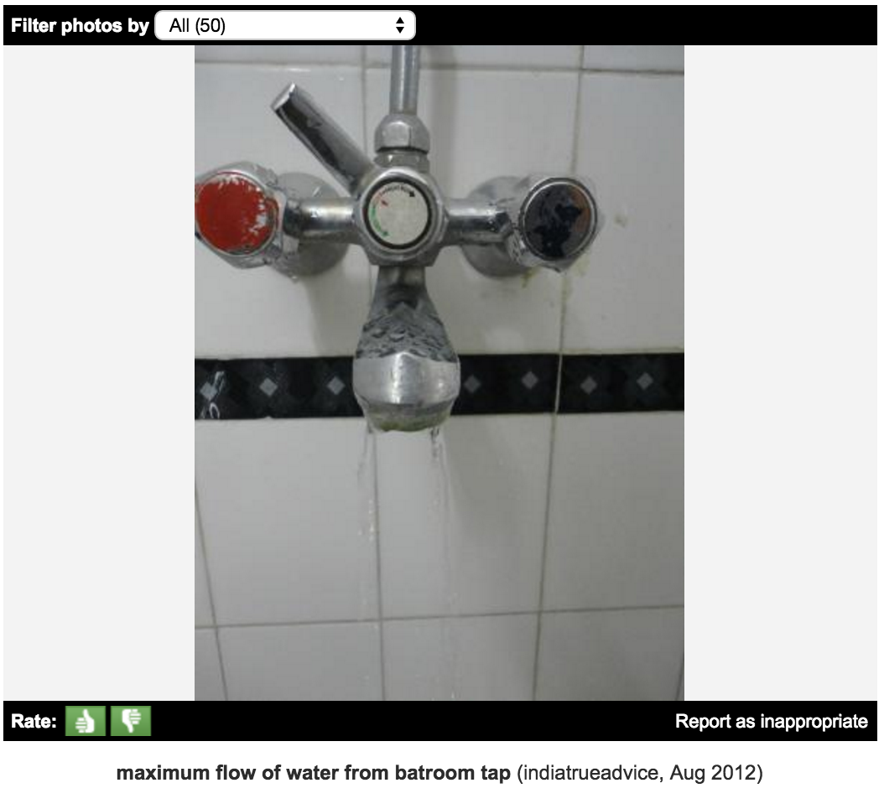
Single-source shortest paths, relaxation, Bellman-Ford Dijkstra's algorithm All pairs shortest paths Maximum Flows

Slide 37
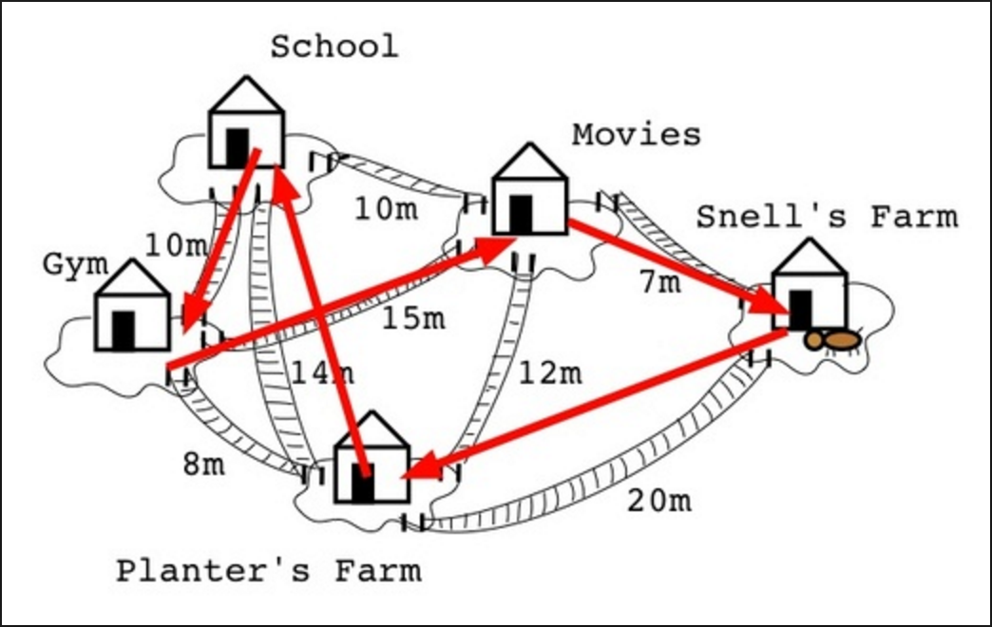
NP-Completeness

Slide 38
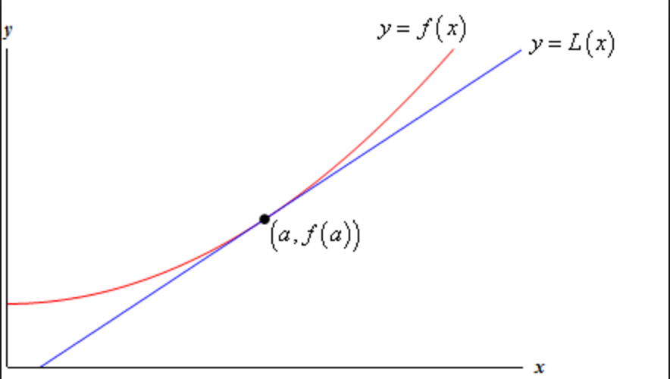
Approximation Algorithms

Slide 39
Syllabus Review
Questions?

Slide 40
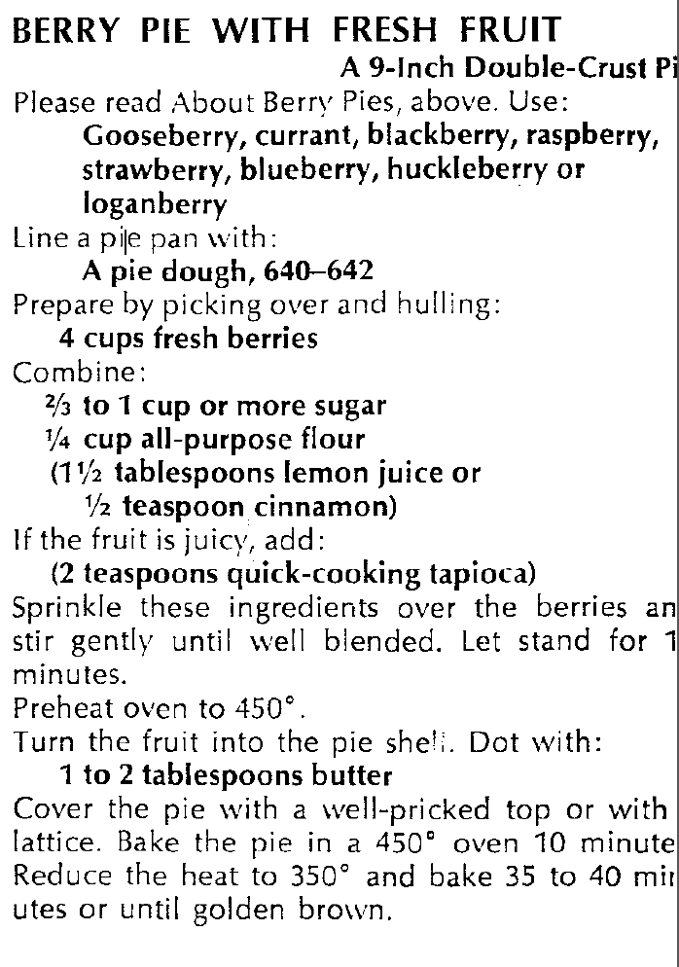
Time for a break
And a metaphor

Slide 41
Overview of Algorithms
A REALLY old Arab guy, or two
Our path forward

Slide 42
Surprise and Shannon
Information Theory
What is information?
Investing in knowledge?

Slide 43
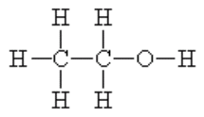
What is this?

Slide 44
discipline of al-jabr
What precisely could that be?

Slide 45
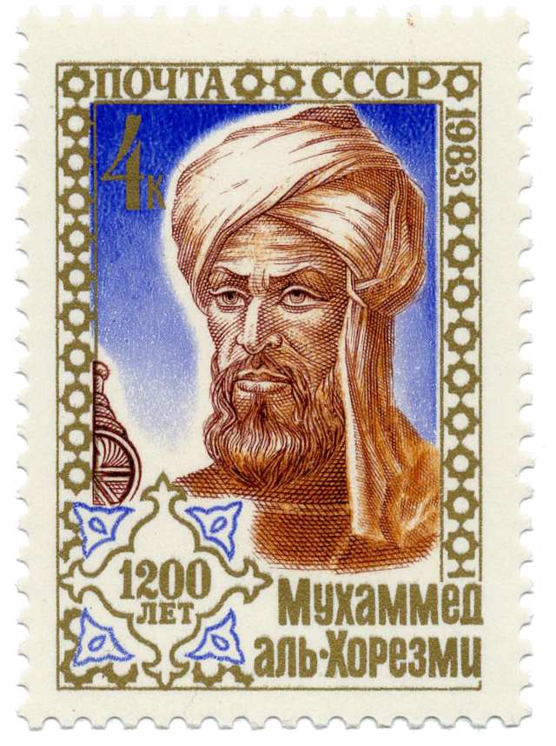
Abū Abdallāh Muḥammad ibn Mūsā al-Khwārizmī

Slide 46
Not the source of algorithm
Al Gore Rhythm?

Slide 47
What is an algorithm?
Algorithm and Entrepreneurial Profit

Slide 48
Why This Course?
You will be able to evaluate the quality of a program (Analysis of Algorithms: Running time and memory space )
You will be able to write fast programs
You will be able to solve new problems
You will be able to give non-trivial methods to solve problems.
(Your algorithm (program) will be faster than others.)

Slide 49
Why This Course?
The Google Interview

Slide 50
Algorithm Descriptions
Natural language: Hindi, English, Russian etc.
Pseudo-code: codes very close to computer languages
I think in C programming language.
Programs: C programs, C++ programs, Java programs.
Goal:
Allow a well-trained programmer to be able to implement.
Allow an expert to be able to analyze the running time.

Slide 51
An Example of an Algorithm
Algorithm sorting(X, n)
Input array X of n integers
Output array X sorted in a non-decreasing order
for i ← 0 to n − 1 do
for j ← i+1 to n do
if (X[i]>X[j]) then
{ s=X[i];
X[i]=X[j];
X[j]=s;
}
return X

Slide 52
To Lesson One
Analyzing Algorithms Deck
Divide And conquer Deck

Slide 53
Wrap-up and review
What were you most confused about today?
Comment on the class
Thank you and Slán abhaile

Slide 54
Notes:
Whaddya think of Poll Everywhere
https://www.polleverywhere.com/multiple_choice_polls/4ncVuShS1ko4u4l

